Slide 1
Advanced Algorithms Mini Project
Sudoku Solver
By Vaibhav Vijay (PES1UG20CS479)

Slide 2
Motivation
- During the COVID-19 pandemic, the popularity of online apps has grown significantly.
- Solving Sudoku helps to improve concentration, reduce anxiety and stress, promotes a healthy competition and improves logical thinking.
- It helps kids develop their problem-solving skills, improve their memory and promotes a positive mindset.
- The game has become popular now in large number of countries and many developers have tried to generate more complicated and interesting puzzles. Today this game appears in every newspapers, books and websites.

Slide 3
Background and Related Work
- Given a partially filled grid of size 9×9, goal is to assign numbers from 1 to 9 to the empty cells such that every row, every column and every sub grid of size 3×3 contains exactly one instance of numbers from 1 to 9.
- This puzzle first appeared in newspapers in November 1892 in France and then Howard Garns, an American architect presented it in its modern form.
- Different authors have made relative works. Nelishia Pillay gives a solution for solving Sudoku by combining human intuition and optimization. This author investigated the use of genetic programming to improve space of programs combined of heuristics moves.
- J.F. Crook has presented an algorithm on how to solve the Sudoku puzzles of differing difficulty with pencil and paper algorithm. But this method has not been implemented and so it is hard to discuss how this algorithm performs.
- Tom Davis has described all techniques that people generally use to solve the puzzles but his major attempt was to describe these techniques from mathematical perspective. But all his strategies may not be required to solve the puzzle.

Slide 4
There are 3 methods of implementing Sudoku solver –
1. Brute Force
This approach is used to generate all possible configurations of numbers from 1 to 9 to fill the empty cells. Try every configuration one by one until the correct configuration is found. After filling all the unassigned positions check if the matrix is safe or not. If safe print else recurs for other cases.
2. Backtracking
Before assigning a number check whether it is safe to assign. After checking for safety assign that number and recursively check whether this assignment leads to a solution or not. If the assignment does not lead to a solution, try next number for the current empty cell. And if none of the numbers from 1 to 9 leads to a solution, then print no solution exists.
3. Bit Masks
This method is a slight optimization to the above 2 methods. For each row or column or box create a bitmask and for each element in the grid set the bit at position ‘value’ to 1 in the corresponding bitmasks.

Slide 5
Brute Force Technique of solving Sudoku
- create a function that checks if the given matrix is a valid sudoku or not. Keep hashmap for the row, column and boxes. If any number has frequency greater than 1 in the hashmap return false else return true
- create a recursive function that takes grid, current row and column index
- if index is at i = N - 1 and j = N, then check if the grid is safe or not. If safe print grid and return true else return false
- if j = N, then do i++ and j = 0.
- if the current index is not assigned then fill elements from 1 to 9 and recur for all 9 cases with index of next element. If the recursive call returns true then break the loop and return true.
- if the current index is assigned then call the recursive function with the index of the next element.
- since for every unassigned index there are 9 possible options, so time complexity is O(9^(N^2))
- since for storing the output array a matrix is needed, so space complexity is O(N^2)

Slide 6
Backtracking Technique of solving Sudoku
- create a function that checks after assigning the current index if grid becomes unsafe or not. Keep hashmap for row, column and boxes. If any number has frequency greater than 1 in the hashmap return false else return true. hashmap can be avoided by using loops.
- create a recursive function that takes a grid.
- check for any unassigned location
- if present then assign a number from 1 to 9.
- check if assigning the number to current index makes the grid unsafe or not.
- if safe then recursively call the function for all safe cases from 0 to 9.
- if any recursive call returns true end the loop and return true. If no recursive call returns true then return false.
- if there is no unassigned location then return true.
- since for every unassigned index there are 9 possible options, so time complexity is O(9^(N^2)). The upper bound time complexity remains the same but there will be some early pruning which makes the time taken much lesser than brute force technique
- since for storing the output array a matrix is needed, so space complexity is O(N^2)

Slide 7
Bit Masks Technique of solving Sudoku
- create 3 arrays each one for rows, columns and boxes of size N.
- boxes are indexed from 0 to 8. In order to find the box index use this formula: row / 3 * 3 + column / 3.
- map the initial values of grid
- each time we add an element to the grid or remove an element from the grid set the bit to 1 or 0 accordingly to the corresponding bitmasks.
- since for every unassigned index there are 9 possible options, so time complexity is O(9^(N^2)). Time complexity remains the same but checking if a number is safe to use takes O(1).
- since for storing the output array a matrix is needed and 3 extra arrays of size N are required for bitmasks, so space complexity is O(N^2).

Slide 8
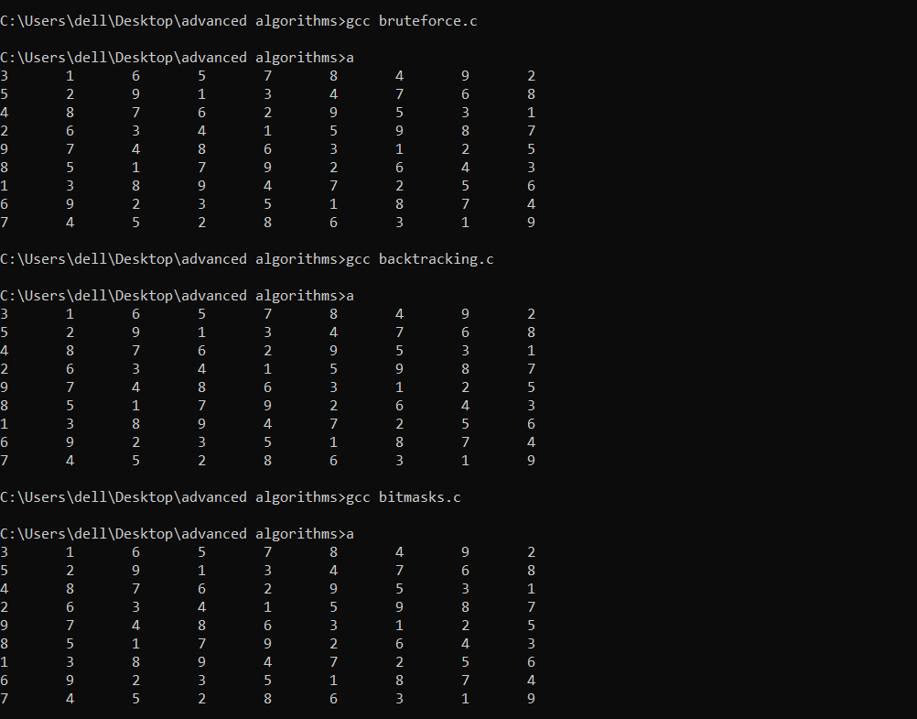

Slide 9
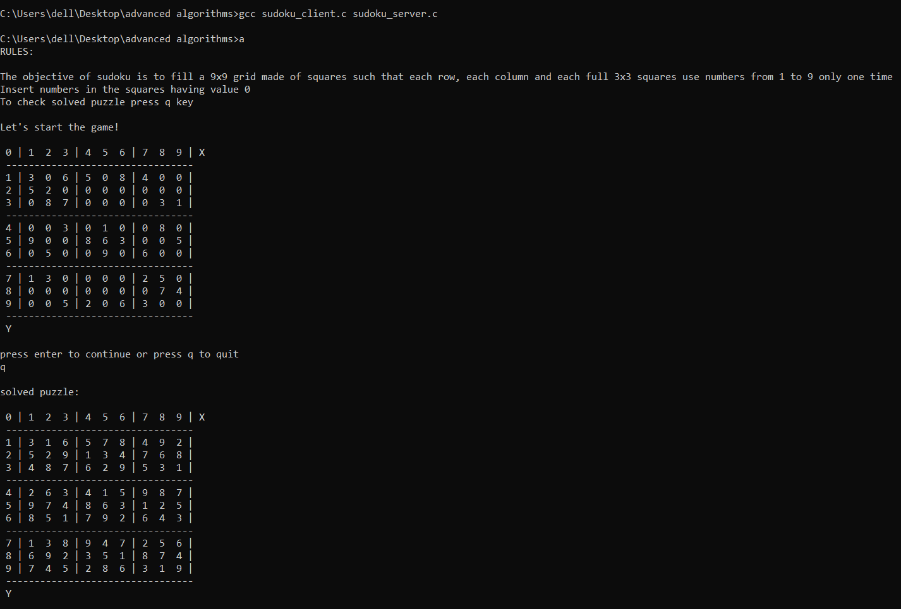

Slide 10


